Slide 1
Input and Menus
Advanced Games Engine Creation

Slide 2
Introduction
Today we will
review SDL input
look at using gamepads for input
discuss how to implement menus in SDL/OpenGL

Slide 3
SDL input review
how do we currently process input in the skeleton SDL application?
in Souce.cpp update method:
//Declare an empty SDL_Event structre
SDL_Event e;
//Get the first even the event queue
SDL_PollEvent(&e);
//Handle any events.
switch(e.type)
{
// Window X has been clicked - Quit
case SDL_QUIT:
return true;
break;
default:
gameScreenManager->Update((float)(newTime-gOldTime)/1000.0f, e);
break;

Slide 4
SDL input
we have checked for the QUIT event (Window X)
Update() returns false if we find it
exit game loop, call CloseSDL() to clean up allocated objects, quit SDL subsystems, exit program
in main method:
//Game Loop.
while(!quit) {
Render();
quit = Update();
}
}
CloseSDL(); //method which closes Window and frees resources.
return 0;
}

Slide 5
Handling other events
we can pass these on to the GameScreenManager Update() method, which passes them on to the current GameScreen, which can pass them on to user-controlled objects….
in this case we are dealing with input events
we are only getting the first event in the queue each frame
SDL_PollEvent(&e);
//Handle any events.
switch(e.type)
might be better to use a while loop?
PollEvent returns 0 when the event queue is empty
while (SDL_PollEvent(&e) ) {
// add the event to a container of events to be passed to GameScreenManager Update method
Or create a GameInput module (a Singleton) which
empties the queue every frame and updates its state
Can be queried by other game objects in their update method

Slide 6
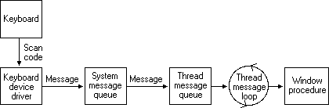
Keyboard Input handling in Windows programs
scan code - identifier for key on keyboard
device-dependent
keyboard device driver
device-dependent – translates scan code to device independent virtual key code
creates key down message composed of virtual key code, scan code, repeat count and other information

Slide 7
Keyboard message processing
System sends message to whichever application has focus
active (uppermost) window
a application will raise a corresponding event
which can be handled at application, form or control level
keyboard events
KeyDown
which key was pressed + modifier (SHIFT, CTRL, ALT)
KeyPress
raised after KeyDown, if the key combination is a character
character code
65, 97 or 1 for A, a or <alt>a
KeyUp
which key was released

Slide 8
Keyboard event handling
Key press information reaches application through a message queue
takes time
event driven model
wait for input, then process it
Holding a key down can generate multiple key events
repeat key down

Slide 9
Events and SDL
when keyboard and other events reach an SDL application they are converted to SDL events and placed in the event queue
the SDL_Event structure is a union of structures with fields for different types of event
https://wiki.libsdl.org/SDL_Event
see below for event types and associated structures https://wiki.libsdl.org/SDL_Event?highlight=%28%5CbCategoryStruct%5Cb%29%7C%28CategoryEvents%29
common types: SDL_QUIT, SDL_MOUSEMOTION, SDL_MOUSEBUTTONODOWN, SDL_KEYDOWN, SDL_KEYUP
keysym member tells us which key

Slide 10
Handling key up events in a menu
void MenuScreen::HandleInput(SDL_Event e) {
switch (e.type) {
case SDL_KEYUP:
switch (e.key.keysym.sym) {
case SDLK_UP:
// scroll up 1
break;
case SDLK_DOWN:
// scroll down 1
break;
case SDLK_RETURN:
// deal with the menu choice
break;
}
}
}
see https://wiki.libsdl.org/SDL_Keycode for a complete list of SDL key codes

Slide 11
Event-driven vs. direct input
Event messages have to pass through Windows message system and be put in the event queue
take time to reach application
we only deal with them once a frame when we poll the queue
the alternative is to poll the input device directly
get the current state of the system
list of pressed keys
whether a mouse button is pressed
don't see the events

Slide 12
Current state example
// move object based on current keystate
const Uint8* currentKeyStates = SDL_GetKeyboardState(NULL);
if( currentKeyStates[ SDL_SCANCODE_UP ] ) {
// move object up
}
else if( currentKeyStates[ SDL_SCANCODE_DOWN ] ) {
// move object down
}
else if( currentKeyStates[ SDL_SCANCODE_LEFT ] ) {
// …..

Slide 13
Direct device polling
finer control, smooth movement, responsive
even short key presses will last several frames
sometimes you want to only act on the initial key press
pressing the space bar shoots only 1 bullet
in other cases you want the action to continue as long as the key is pressed
to detect new key presses
declare a KeyboardStates variable to hold the previous frame's keyboard state
compare it to the current keyboard state – only act if it has changed
at the end of the update method, set the previous keyboard state to equal the current state

Slide 14
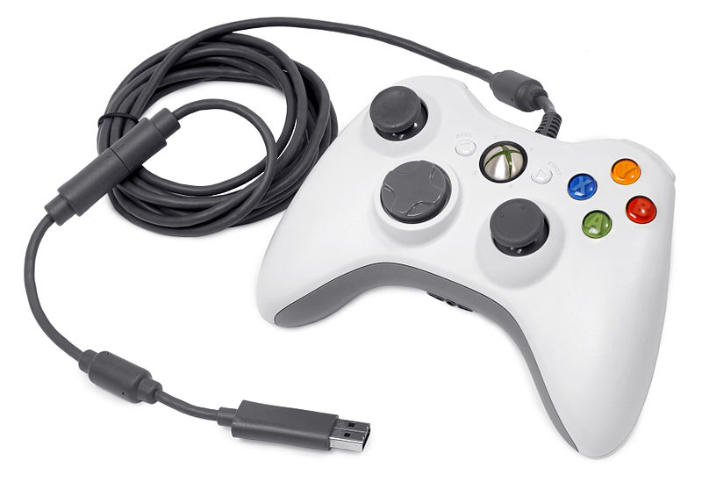
Types of input device
digital – on or off
button
mouse, gamepad
keyboard
lots of buttons
analogue – range of values
mouse
x, y position
gamepad
sticks and triggers

Slide 15
Dead zone
analogue devices can have a dead zone
range of values which are treated as equivalent to default value (no input)
near centre position of joystick, up position of trigger
makes it easier to steer with!
06/03/2016
Notes:
06/03/2016
15

Slide 16
SDL Joysticks
SDL has a subsystem to handle joysticks
which can be extended to handle gamepads
needs to be initialised if using
if( SDL_Init( SDL_INIT_VIDEO | SDL_INIT_JOYSTICK ) < 0 ) { // failed, exit program }
// suceeded, now we can use the joystick
see http://lazyfoo.net/tutorials/SDL/19_gamepads_and_joysticks/index.php for a walkthrough
https://wiki.libsdl.org/CategoryJoystick for documentation

Slide 17
SDL Gamepads
maps gamepad buttons to joystick API
see https://wiki.libsdl.org/CategoryGameController
functions available to get the current state of a button
or the current value of an axis or trigger
-32768 to 32767 for an axis
0 to 32767 for a trigger
check if outside the dead zone you have defined

Slide 18
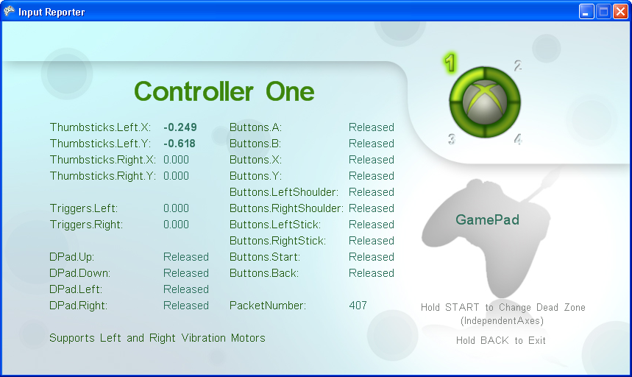
Gamepad input
0 to 32767
-32768 to 32767

Slide 19
Gamepad dead zones
can use different types of deadzone
circular deadzone
compare X² + Y² against (deadzone)²
good for 2D movement using control stick
total distance from centre important

Slide 20
Square deadzone
compares |X| against deadzone when returning X
compares |Y| against deadzone when returning Y
magnitude of deflection in each direction important

Slide 21
Gamepad vibration
gamepad has 2 motors for vibration
left – low frequency
right – high frequency
can set speed of each and duration of rumble
need to declare and initialise haptic system
see http://lazyfoo.net/tutorials/SDL/20_force_feedback/index.php

Slide 22
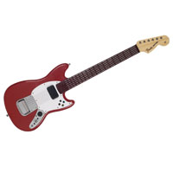

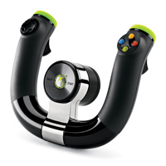
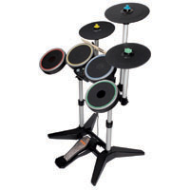
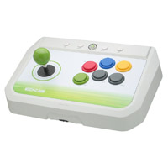
More XBox 360 controllers

Slide 23
Using alternative input devices
these controllers map to buttons and analogue controls on the gamepad
all alternative controllers must support
The action buttons: A, B, X, and Y.
The Back, Start, and Xbox Guide buttons.
The directional pad (Up, Down, Left, and Right)
Drum kit:
Green, Red, Blue, and Yellow pads correspond to gamepad A, B, X, and Y buttons

Slide 24
Making menus with OpenGL/SDL
menus and splash screens are normally 2D
define a new level for each menu or splash screen (subclass of GameScreen)
may want to have a parent class of each type
change the projection type to orthographic
Just like HUD last semester
render menu strings or images
highlight one by rendering it in a different colour / larger
move the highlight up and down with the arrow keys
handle selected menu item when the user confirm (X button or enter key)

Slide 25
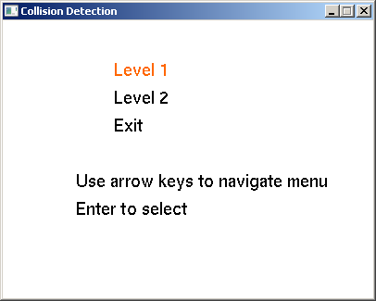
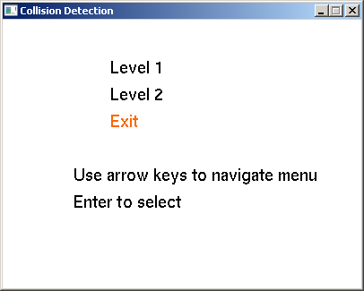
Menus

Slide 26
A menuscreen header
class MenuScreen : public GameScreen {
public:
MenuScreen(GameScreenManager * gsm);
~MenuScreen() {};
void Render();
void Update(float deltaTime, SDL_Event e);
protected:
void HandleInput(SDL_Event e);
vector<string> mInstructions;
vector<string> mMenuItems;
private:
int selected = MENU_NONE;
void HandleSelectedItem();
};
#endif
ifndef MENU_SCREEN_H
#define MENU_SCREEN_H
#include <vector>
#include <string>
#include "GameScreen.h"
using namespace std;
#define MENU_NONE -1
#define MENU_LEVEL1 0
#define MENU_LEVEL2 1
#define MENU_EXIT 2

Slide 27
Menuscreen initialisation
MenuScreen::MenuScreen(GameScreenManager * gsm) : GameScreen(gsm) {
mMenuItems.push_back("Level 1");
mMenuItems.push_back("Level 2");
mMenuItems.push_back("Exit");
if (mMenuItems.size() != 0) {
selected = MENU_LEVEL1;
}
mInstructions.push_back("Use arrow keys to navigate menu");
mInstructions.push_back("Enter to select");
}

Slide 28
Menusceen rendering
int i;
for (i = 0; i< mMenuItems.size(); i++) {
if (i == selected) {
glColor3f(1.0f, 0.4f, 0.0f);
}
else {
glColor3f(0.0, 0.0, 0.0);
}
OutputLine(30, 80 - 10 * i, mMenuItems[i]);
}
for (int j = 0; j < mInstructions.size(); j++) {
glColor3f(0.0, 0.0, 0.0);
OutputLine(20, 70 - 10 * j - 10 * i, mInstructions[j]);
}
glPopMatrix();
glMatrixMode(GL_MODELVIEW);
glPopMatrix();
}
void MenuScreen::Render() {
glClearColor(1.0f, 1.0f, 1.0f, 0.0f);
glMatrixMode(GL_MODELVIEW);
glPushMatrix();
glLoadIdentity();
glMatrixMode(GL_PROJECTION);
glPushMatrix();
glLoadIdentity();
gluOrtho2D(0, 100, 0, 100);
//Clear the screen.
glClear(GL_COLOR_BUFFER_BIT | GL_DEPTH_BUFFER_BIT);

Slide 29
MenuScreen Update
void MenuScreen::Update(float deltaTime,SDL_Event e) {
HandleInput(e);
}
void MenuScreen::HandleInput (SDL_Event e) {
switch (e.type) {
case SDL_KEYUP:
switch(e.key.keysym.sym) {
case SDLK_UP:
if (selected > 0) {
selected =selected-1;
}
break;
case SDLK_DOWN:
if (selected < mMenuItems.size()-1)
{
selected++;
}
break;
case SDLK_RETURN:
HandleSelectedItem();
break;
}
}
}

Slide 30
Adding to the SDL event queue
we can add events to the SDL event queue
simulate input to be handled elsewhere
for example, we could add a quit event in response to a menu choice:
switch (choice) {
case QUIT:
// simulate a Window close event
SDL_Event sdlevent;
sdlevent.type = SDL_QUIT;
SDL_PushEvent(&sdlevent);
break;
//…..
When this is read from the event queue, it will be treated the same as a window close (X)

Slide 31
Further Reading
SDL Documentation https://wiki.libsdl.org/APIByCategory
Lazy Foo Production SDL tutorials
http://lazyfoo.net/tutorials/SDL/index.php

